Slide 1


Slide 2
SEQUENTIAL CIRCUITS
Dr.S.Vaaheedha Kfatheen
Assistant Professor
Department of Computer Science & IT
Jamal Mohamed College (A)
Trichy – 620 020.

Slide 3
FLIP FLOPS
In a sequence circuit the output at any point of time depend not only o the present inputs. But also on the previous input sequence.
Sequential circuits are characterized by memory and a feedback between the outputs and inputs.
A sequence circuit is constructed from combinational circuit, with a feedback path between the output and input.

Slide 4
Definition
A flip flop is a Bi-stable device (that is) it can remain in one of the two stable state which are designated as 0 and 1 state.
Inputs
Outputs
Combinational circuit
Memory elements

Slide 5
It is the fundamental logic circuit used for storing information in digital systems.
Difference types of shift registers and counters are design only using flip flops, which can be built using NOR gates or NAND gates.
A flip flops has two outputs, one of which is the complement of the other.
They are called normal (Q) output and complementary (Q’) output.

Slide 6
A NAND LATCH
NAND latch or NOR latch is the fundamental built in block in constructing a flip flop.
It has the property of holding on to any previous output, as long as it is not disturbed.

Slide 7
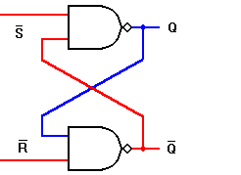

Slide 8
A latch has 2 outputs Q and Q’
When the circuit is switched ON the latch may enter into any state.
If Q=1, then Q’=0 which is called SET state
If Q’=0, then Q=1, which is called RESET state
Whether the latch is in SET state or RESET state it will continue to remain in the same state as long as the power is not switched OFF.

Slide 9
The latch is not an useful circuit since there is no way of entering the desired input.
It is the fundamental building block in constructing the flip flop.

Slide 10
1. RS FLIP FLOP
- RS flip flop is constructed with 4 NAND gates it has two inputs S and R & two outputs Q & Q’.
Block Diagram
R Q
S Q’
RS FLIP FLOP

Slide 11
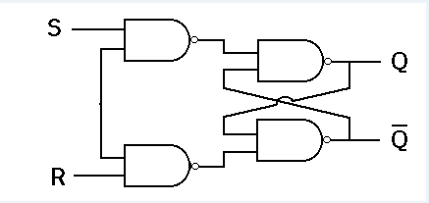
LOGIC DIAGRAM

Slide 12
INPUT OUTPUT
S R Q(n+1) MODE
0 0 0 HOLD
0 1 0 RESET
1 0 1 SET
1 1 1 PROHIBITED

Slide 13
The working of the RS flip flop is as follows:
CASE 1: When S=0 and R=0 both the NAND gates A and B output is 1.
Hence the outputs of C & D depend only on the feedback inputs
The entire circuit behaves as a latch
The circuit will hold on to its previous output
This state is called Hold State.

Slide 14
CASE 2:
When S=0 and R=1 NAND gate A output will be 1 and B output is 0.
The output of D (that is ) Q’ will be 1, making both inputs to get C as 1.
Hence Q will be in 0 state. This state of flip flop is known as RESET state.

Slide 15
CASE 3:
When S=1 and R=0, then Q=0 and Q=1
This state of the flip flop is known as SET state.
CASE 4:
When S=1 and R=1, this input condition is prohibited because when both Q & Q’ =1.
This is against the principle of operation of a flip flop.

Slide 16
Moreover if the inputs are now change, the next state of the flip flop is unpredictable.
The next state actually depends on which gate faster to change its present state.
This prohibited state is also called as RACE condition.

Slide 17
CLOCKED RS FLIP FLOP
A clock is a timing signal, generate by a master clock generator in a digital system.
These timing signals are distributed through out the digital system.
The clock waveform is a square waveform.
The clock signal synchronous various functional units.
It determines when a system should have an input and generate an output.

Slide 18
When a clock signal applied at the input of a gate, it is enable only when the clock is 1.
When the clock is 1, the other inputs to the gate are accepted by the gate.
When the clock is 0, the inputs are not accepted by the gate.

Slide 19
Block Diagram
R Q
S Q’
RS FLIP FLOP
Clock

Slide 20
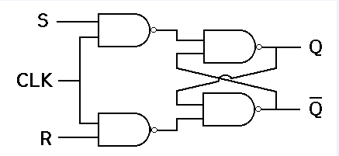
Logic Diagram

Slide 21
Characteristic Table
INPUTS OUTPUTS
Clk S R Q(n+1) MODE
0 X X Q(n) HOLD
1 0 0 Q(n) HOLD
1 0 1 0 RESET
1 1 0 1 SET
1 1 1 * RACE

Slide 22
It has 3 inputs, S,R and Clk
It has 2 outputs Q and Q’
The operation of the RS flip flop is as follows.
If there is no signal at the clock input, the output of the circuit cannot change irrespective of the values at input S & R.
Only when the clock signals change from 0 to 1 the output will be affected according to the values in input S & R.

Slide 23
If S=1 and R=0 output Q is SET to 1.
If S=0 and R=1 output Q is cleared to 0.
If both S and R =0 the output does not change.
When both S and R=1 the output is unpredictable.
This state is referred to as forbidden state.
The x on the table show that when clock=0, whatever may be the values of S & R the circuit does not respond.

Slide 24
D FLIP FLOP
Block Diagram
D Q
Q’
D FLIP FLOP
Clock

Slide 25
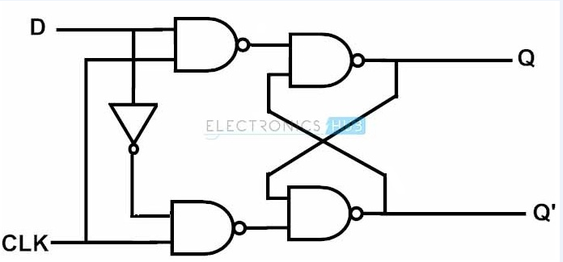

Slide 26
CLK D Q(n+1) MODE
0 X Q(n) HOLD
1 0 0 RESET
1 1 1 SET

Slide 27
An SR flip flop is converted to a D flip flop by inserting an inverter between S & R and assigning the symbol D to the single input.
The D input is sampled during the occurrence of a clock transition from 0 to 1.
If D=1, the output of the flip flop goes to the one state.
If D=0, the output of the flip flop goes to the zero state.
D flip flop is also called as transparent latch

Slide 28
J K FLIP FLOP
The prohibited or RACE condition of the RS flip flop is eliminated by modifying it into a JK flip flop.
In this flip flop the output Q and Q of an flip flop are feed back to the RS inputs using two AND gates must be inputs.

Slide 29
J K FLIP FLOP
Block Diagram
J Q
K Q’
RS FLIP FLOP
Clock

Slide 30
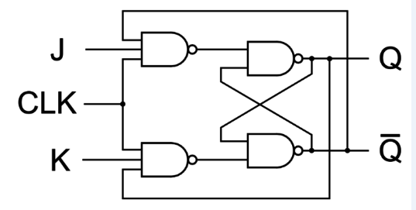

Slide 31
Characteristic Table
INPUTS OUTPUTS
Clk J K Q(n+1) MODE
0 X X Q(n) HOLD
1 0 0 Q(n) HOLD
1 0 1 0 RESET
1 1 0 1 SET
1 1 1 Q(n) TOGGLE

Slide 32
- The circuit diagram and characteristic table of the JK flip flop shows that it has 3 inputs J,K and clock and it has 2 outputs Q and Q.
If there is no signal and the clock input the output of the circuit cannot change irrespective of values at J and K.
When the clock signal=1, the J and K inputs are processed.
If J=1 and K=0 output is SET to 1.
If J=0 and K=1 output is cleared to 0.
When J=1 and K=1 a clock transition switches the outputs of the flip flop to their complement state.

Slide 33
T FLIP FLOP
Block Diagram
T Q
Q’
T FLIP FLOP
Clock

Slide 34
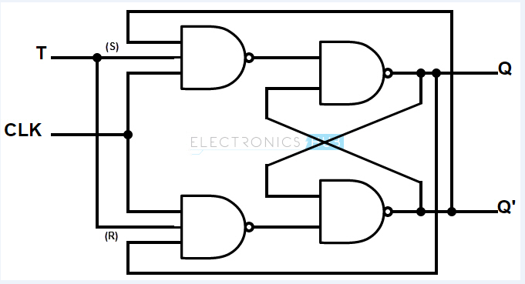

Slide 35
CLK T Q(n+1) MODE
0 X Q(n) HOLD
1 0 Q(n) HOLD
1 1 Q’(n) TOGGLE

Slide 36
It has two inputs T and clock.
This T flip flop is obtained from a J & K flip flop when inputs J and K are connected to provide a single input designated by T.
The T flip flop has only two conditions when T=0 the clock transition does not change the state of the flip flop.
When T=1, a clock transition complements the state of the flip flop.

Slide 37
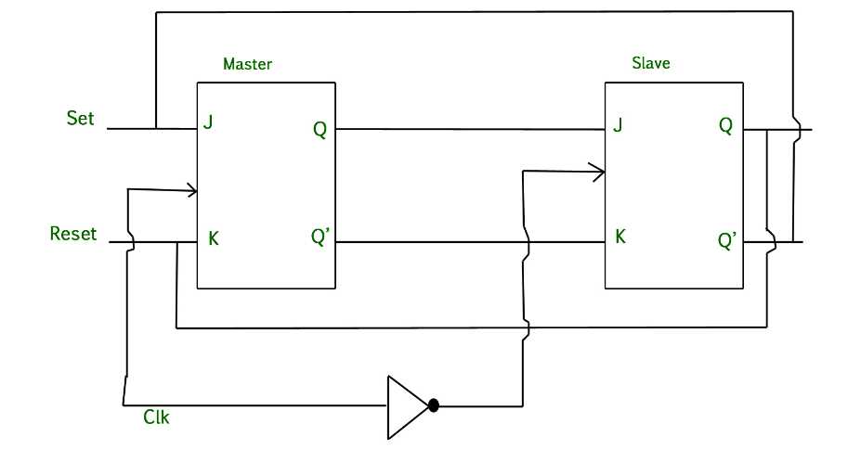
MASTER SLAVE FLIP FLOP

Slide 38
In a JK flip flop, if it is clocked, a situation called RACE condition will occur.
This happens when the inputs J&K are equal to 1 and the clock period is much larger than the propagation delay of the gates.
Under this situation when the new outputs RACE around to the inputs. They find the clock to be still high and hence cause the outputs toggle again.

Slide 39
This repeats as long as the clock is high and the final output when the clock becomes low is unpredictable.
This problem can be eliminated by using a Master-Slave flip flop.
A Master-Slave flip flop consists of 2 cascaded JK flip flop
The clock to 1 flip flop, master is inverted and applied to the other flip flop, slave.
Hence, whenever master is active and the slave is inactive and vice versa.

Slide 40
The master will accept the JK inputs when the clock makes a positive transition and the slave will copy the master’s output at its output when the clock makes a negative transition.
It is to be noted that the final output appears only when the clock is low.
When J=1 and K=0- The master flip flop is SET to 1 during the positive clock pulse and the slave is SET during the following negative clock pulse.

Slide 41
When J=0 and K=1
The master flip flop is RESET to 0 during the positive clock pulse and the slave is RESET during the following negative clock pulse.
When J=1 and K=1
The master flip flop toggles during the positive clock pulse and the slave toggles during the following negative clock pulse.

Slide 42
COUNTERS
A counter is a sequential logic circuit that counts the number of incoming clock pluses.
A register that goes through a pre-determined sequence of state upon the application of input pulses.
USES
Counts the number of incoming clock pluses.
Generating timing signal to control the sequence of operation in digital computers.

Slide 43
Basically there are two types of counters.
  1. Synchronous
  2. Asynchronous
  Asynchronous counters or serial counter
  The ripple counter is simple and straight forward in operation.
  Construction requires a minimum of hardwires.
  It have a speed limitation.
  Each flip flop is triggered by the previous flip flop.

Slide 44
Synchronous or parallel counter
An increase in speed of operation can be achieved by use of a parallel counter.
Every flip flop is triggered by the clock
Serial and parallel counters are used in combination to compromises between speed of operation and hardware count

Slide 45
Asynchronous counters(Ripple counters)
- A binary ripple counter can be constructed by use of clocked JK flip flop.

Slide 46
3 bit binary ripple counter
J A
K A’
J A
K A’
J A
K A’
Clock
A
B
C

Slide 47
Truth Table
CLOCK TRANSITION | C | B | A
0 | 0 | 0 | 0
1 | 0 | 0 | 1
2 | 0 | 1 | 0
3 | 0 | 1 | 1
4 | 1 | 0 | 0
5 | 1 | 0 | 1
6 | 1 | 1 | 0
7 | 1 | 1 | 1
0 | 0 | 0 | 0

Slide 48
The system clock (a square wave) derives flip flop A
The output of A derives B and the output of B derives flip flop C
All the J and K inputs are tied to +Vcc. This means that each flip flop will change state with a –Ve transition at its clock input.
The flip flop must change states before it can triggered the B flip flop and the B flip flop has to change states before it can trigger the c flip flop.

Slide 49
The triggers move through the flip flops ripple in water.
A act as the clock for B, each time the wave form at A goes low, flip flop B will toggle.
Since B act as the clock for C each time the waveform at B goes low flip flop C will Toggle.

Slide 50
Synchronous counters
Ripple counter is the simplest counter to build
But there is a limit to its highest operating frequency.
In ripple counter each flip flop has a delay time
Total setting time for the counter is approximately the delay time. Times the total number of flip flops.
These problems can be overcome by the use of a synchronous or parallel counter.
In synchronous counter every flip flop is triggered in synchronization with the clock.

Slide 51
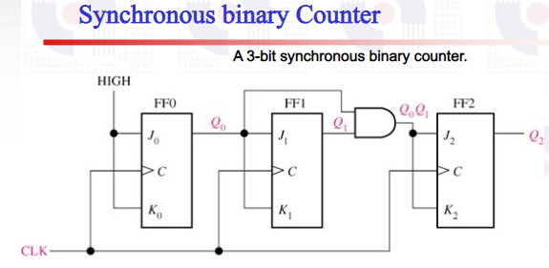

Slide 52
Truth Table
C | B | A | CLOCK COUNT
0 | 0 | 0 | 0
0 | 0 | 1 | 1
0 | 1 | 0 | 2
0 | 1 | 1 | 3
1 | 0 | 0 | 4
1 | 0 | 1 | 5
1 | 1 | 0 | 6
1 | 1 | 1 | 7
0 | 0 | 0 | 0

Slide 53
Each state corresponds to an equivalent binary number, that we refer to each state as a count from now on.
To keep the JK inputs of each flip flop high, such that the flip flop will toggle with any negative transition at its clock inputs.
Use AND gates to every second clock to flip flop B, every 4th clock to flip flop C and so on.

Slide 54
The logic configuration is also called as steering logic.
Since, the clock pulses are gated or steered to each individual flip flop.
The clock is applied directly to flip flop A.
Since the JK flip flop used response to a –ve transition at the clock input and toggles when both the JK inputs are high, flip flop A will change state with each negative clock transition.

Slide 55
- Whenever A is high AND gate is enabled and a clock pulse is passed through the clock input of the flip flop B.
- B changes state with every –ve clock transition and the second AND gate is enabled and will transmit the clock to flip flop C.
- Only when both A and B are high, flip flop C changes state with every 4th –ve clock transition.

Slide 56
MOD n COUNTER
Modulus of a counter indicates the number of states through which counter passes during its operation.
2 bit counter – Mod 4 counter
3 bit counter – Mod 8 counter

Slide 57
MOD N counter is also called as Modulo counter
We can design Modulo counter for any number
Example Modulo 3, Modulo 5
The design of such modulo counter includes basic counter structure and combinational logic called “Reset Logic”

Slide 58
Number of flip flops required (m) to construct MOD-N counter
N ≤ 2^{m}

Slide 59
Steps for Modulo Counter Design
1. Number of states through counter passes
2. Decide number of bits for Ripple counter
3. State Diagram
4. Truth table for Reset Logic
5. K-Map simplification
6. Logic Diagram

Slide 60
Modulo 5 Ripple Counter (A)
Number of states through counter passes =5
States will go from 0 to 4.
2. Decide number of bits for Ripple counter
To count 5 states we need 3 bit ripple counter N ≤ 2^{m}

Slide 61
3. State diagram
0
1
2
3
4

Slide 62
4. Truth table for Reset Logic
State | Flip-flop Output |  |  | Reset Logic Output Y
 | QC | QB | QA
0 | 0 | 0 | 0 | 1
1 | 0 | 0 | 1 | 1
2 | 0 | 1 | 0 | 1
3 | 0 | 1 | 1 | 1
4 | 1 | 0 | 0 | 1
5 | 1 | 0 | 1 | 0
6 | 1 | 1 | 0 | 0
7 | 1 | 1 | 1 | 0
States from 0-4 are only valid states

Slide 63
5. K-Map simplification
Q_{C}
Q_{A} QB Y = Q_{C} + Q_{A}Q_{B}
Q_{A} Q_{B}
Q_{C}
00 01 11 10
0
1
1 1 1
1 0 0 0

Slide 64
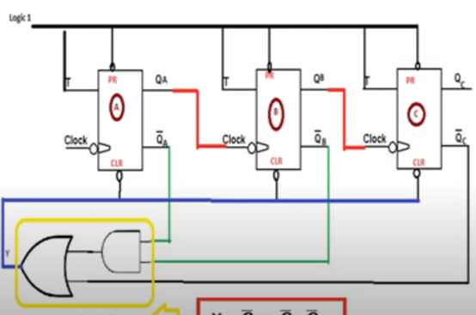
6. Logic Diagram for Reset-Logic

Slide 65
References
1. Albert Paul Malvino, Donald P. Leach and
Goutam Saha, Digital Principles and
Applications,TMH, Sixth Edition, 2007.
2. Morris Mano M, Computer System
Architecture, PHI, Third Edition, 2008

Slide 66


